Slide 1

Unit 02.03.02
CS 5220:
COMPUTER COMMUNICATIONS
MAC Random Access - ALOHA
XIAOBO ZHOU, Ph.D.
Professor, Department of Computer Science

Slide 2
Random Access
Random access
  No scheduling overhead
  Delay-bandwidth product is important factor
  Uniform frame size

Slide 3
ALOHA
Wireless link to provide data transfer between campuses of University of Hawaii, a simple scheme
  A station transmits whenever it has data to transmit
  If more than one frames are transmitted, they collide with each other and lost
  If ACK not received within timeout, then a station picks random backoff
  Station retransmits frame after backoff time
First transmission
Retransmission
Backoff period B
t
t₀-X
t₀
t₀+X
t₀+X+2t_{prop}
t₀+X+2t_{prop} + B
Vulnerable
period
Time-out

Slide 4

ALOHA Model
Definitions and assumptions
  X: frame transmission time (assume constant)
  S: throughput (average # successful frame transmissions per X seconds)
  G: load (average # transmission attempts per X sec.)
  P_{success} : probability a frame transmission is successful
Any transmission that begins during vulnerable period leads to collision
Success if no arrivals during 2X seconds
X
X
Prior interval
Reference frame transmission

Slide 5
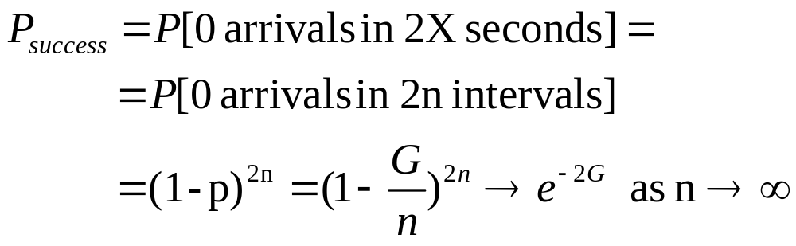
Abramson’s Assumption
What is probability of no arrivals in vulnerable period?
  Abramson assumption: Effect of backoff algorithm is that frame arrivals are equally likely to occur at any time interval
  G is avg. # arrivals per X seconds, divide X into n intervals of duration Δ = X/n
  p = probability of arrival in Δ interval, then G = n p since n intervals in X seconds
S = Ge^{-2G}

Slide 6
Slotted ALOHA
ALOHA performance depends on probability of collisions
Reducing vulnerable period can reduce collision probability
Slotted ALOHA reduces collision probability by constraining the stations to transmit in synchronized manner.

Slide 7
Slotted ALOHA Model
Time is slotted in X seconds slots (X is frame transmission time)
Stations synchronized to frame times (may incur waiting time)
Stations transmit frames only at the beginning of a time slot
Backoff intervals in multiples of slots
Backoff period B
t
kX
(k+1)X
t₀ +X+2t_{prop}
t₀ +X+2t_{prop}+ B
Vulnerableperiod
Time-out

Slide 8
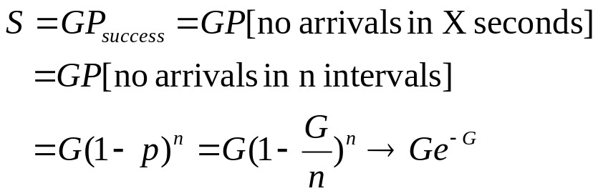
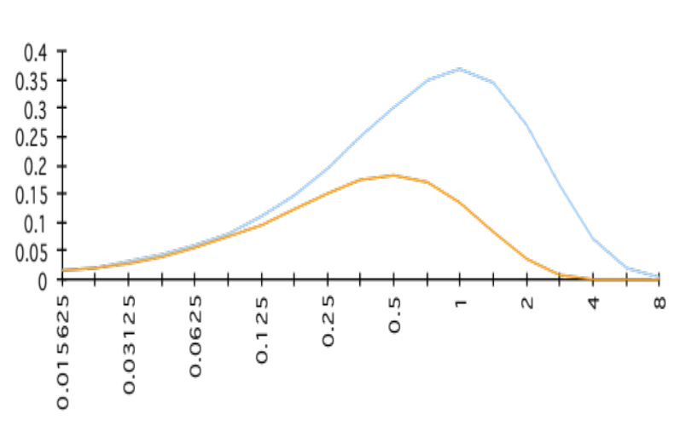
Throughput of Slotted ALOHA
1/e=0.368
Ge^{-G}
S
1/2e = 0.184
Ge^{-2G}
G

Slide 9
Summary
ALOHA schemes are simple, but low maximum system throughput

